Slide 1
SAMOA Initial Research (part 1)
Li Huang

Slide 2
Outline
1.What’s SAMOA
2.Setup S4
3.Setup SAMOA
4.An SAMOA Example

Slide 3
1.What’s SAMOA
Scalable Advanced Massive Online Analysis
by Yahoo starting at 2013 Oct.
A framework for mining big data streams in a cluster/cloud environment.
Written in Java
Running on Linux
Current version: 0.0.1
Developers: about 3 people

Slide 4
Questions
Why Yahoo develop SAMOA ?
SAMOA’s Architecture ?
Current Ability ?
Advantages and disadvantages ?

Slide 5
Q1.Why SAMOA?
1.To deal with Big Data nowadays
3V ( Volume, Velocity, Variety )
Data Stream, a kind of big data:
Data representing measurements, actions and interactions.
E.g.
Data coming from sensor networks or the Web; Online news, micro-blogs, search queries; Real time data.
Data arrives at high speed, and (Streaming) algorithms must process it in one pass under very strict constrains of space and time.
Value of streams: freshness and relatedness to ongoing events
Current solutions for big data analysis
are not designed to deal with evolving streams.

Slide 6
Stream Data properties:
Objects arrive continuously.
Stream sizes can be unbounded and potentially infinite.
There is no guarantee in arrival order of data objects.
Data objects are discarded after being processed.
The data source might be evolving.

Slide 7
Why SAMOA? (ctd.)
Current conventional data mining tools:
1.Non-distribute:
Batch: WEKA, R, SAS …
Batch-(data must be download and stored before analysis. Batch processe need much more space than stream process)
Stream: Aurora, STREAM
2.Distribute:
Batch Distributed Platforms: Hadoop, MapReduce
Data mining tool: Mahout;
Stream Platforms:
Apache(Yahoo) S4, Twitter Storm
But they are generic platforms without data mining tools!

Slide 8
Why SAMOA? (ctd.)
Current conventional data mining tools(ctd.):
3.Stream Machine Learning Frameworks:
MOA(massive online analysis), VFML(very fast machine learning), RapidMiner.
(But they are not distributed)
SAMOA = Distributed stream process platform + Machine learning tools

Slide 9
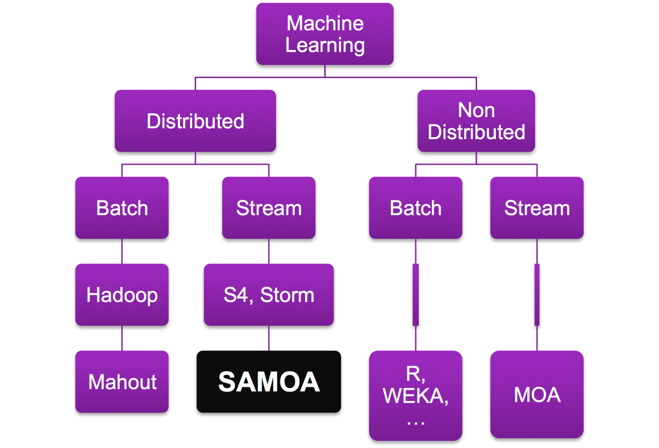

Slide 10
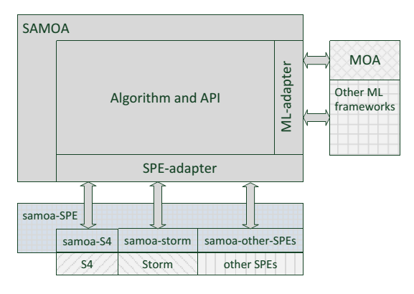
Q2.SAMOA’s Architecture

Slide 11
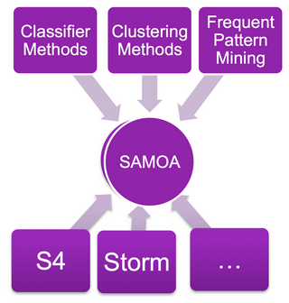

Slide 12
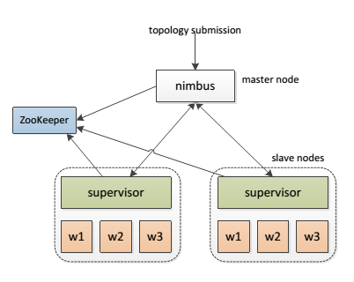
SAMOA’s Architeture
Storm Cluster
A Central server(nimbus), Coordinate servers (ZooKeeper cluster), Processing nodes(supervisors), Workers(w1,w2,w3,…, each is a Java virtual machine(JVM) process)

Slide 13
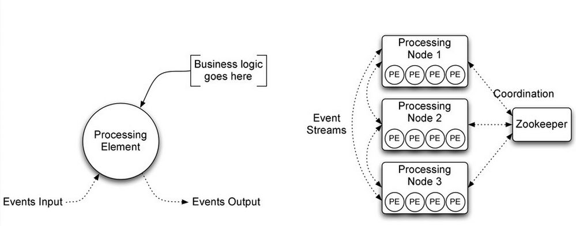
SAMOA’s Architeture
S4 Cluster
PE: Processing Element; Node; Event
Stream: connects PE instances. A PE emits events in a stream and consumes events from a stream.;

Slide 14
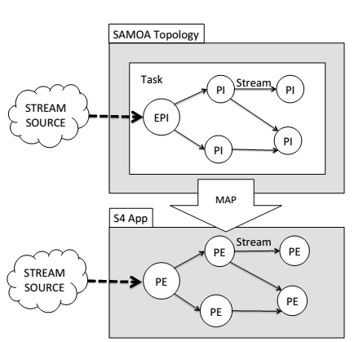
SAMOA’s Architeture(ctd.)
Integrate SAMOA to S4
PI: process items
PI = PE

Slide 15
Q3.Current Ability
Support Modes:
Local (run on single machine);
Storm; S4. (run on a cluster)
Available machine learning algorithms:
1.Prequential Evaluation Task
(evaluating performance of online classifiers)
2.Vertical Hoeffding Tree Classifier
Distributed Decision Tree classifier
(Vertical parallelised VFDT algorithm)
3.Distributed Stream Clustering
4.Distributed Stream Frequent Itemset Mining
Base on PARMA algorithm.
(The itemsets that were frequent last year may not be frequent this year. To handle this, SAMOA implements Time Biased Sampling approach.)

Slide 16
Q4. Advantages and Disadvantages
Advantages:
User can concentrated on Algorithms rather than the detail of a specific SPE.
Write algorithm code once, run on all supported stream process engine.
Disadvantages:
Still beginning, lack of documents and supports.
Only 4 algorithms implemented so far, lack of common data mining algorithms.

Slide 17
2.Setup S4
(Currently I use Virtual Machine on Windows 7)
1.Setup Linux System( Ubuntu Desktop Ver12.04)
2.Setup Gradle 1.4, and configure environment variables.
3.Setup OpenJdk 1.7.
4.Download and setup S4 0.6.0
https://github.com/yahoo/samoa/wiki/Executing-SAMOA-with-Apache-S4
5.Test S4
Start a Zookeeper Server
Create an cluster
Create two nodes
Deploy a “Hello App” onto the cluster
http://incubator.apache.org/s4/doc/0.6.0/walkthrough/
6.Test Twitter Trend Example.
(need a Twitter Account and a Twitter Developer Account)
http://incubator.apache.org/s4/doc/0.6.0/twitter_trending_example/
Detail steps in my computer, please ask me if you need.

Slide 18
3.Setup SAMOA
( Must setup S4 before setup SAMOA )
1.Setup Maven (I use ver.3.0.4)
2.Download and setup SAMOA
http://yahoo.github.io/samoa/
3.Build SAMOA App
Go into the SAMOA directory, excute:
mvn package
mvn -Ps4 package
4.Configure SAMOA
edit the file: bin/samoa-s4.properties
5.Test SAMOA with a App
bin/samoa local target/SAMOA-Local-0.0.1-SNAPSHOT.jar "ClusteringEvaluation"
bin/samoa S4 target/SAMOA-S4-0.0.1-SNAPSHOT.jar "ClusteringEvaluation"

Slide 19
4.A SAMOA Example
App: Forest Cover Type Clustering
1. Download dataset and unzip
http://downloads.sourceforge.net/project/moa-datastream/Datasets/Classification/covtypeNorm.arff.zip
Forest Covertype contains the forest cover type for 30 x 30 meter cells obtained from the US Forest Service (USFS) Region 2 Resource Information System (RIS) data. It contains 581,012 instances and 54 attributes, and it has been used in several articles on data stream classification.

Slide 20
A SAMOA Example (ctd.)
2.classifying the CoverType dataset with the bagging algorithm
bin/samoa local target/SAMOA-Local-0.0.1-SNAPSHOT.jar "PrequentialEvaluation -l classifiers.ensemble.Bagging \ -s (ArffFileStream -f covtypeNorm.arff) -f 100000“
The output will be a list of the evaluation results, plotted each 100,000 instances.
You can add “-d result.csv” in the command to output the result into a .csv file.

Slide 21
The output will be a list of the evaluation results, plotted each 100,000 instances.

Slide 22
